Slide 1
Reporting Weekly Influenza Vaccination Data
Division of Healthcare Quality Promotion
Immunization Services Division
November 2020
Notes:
Welcome to the training session on weekly influenza vaccination data reporting through NHSN. My name is Elizabeth Kalayil, and I work in the Immunization Services Division at CDC. I will be presenting information during this session.

Slide 2
Objectives
Highlight changes and clarification for data reporting
Discuss the value of reporting weekly influenza vaccination data
Describe how facilities can track weekly influenza vaccination of healthcare personnel (HCP)
Review data reporting in detail
2

Slide 3
Overview
Launched weekly influenza vaccination data reporting module in September 2020
Allowed for non-long-term care facilities to report weekly data on HCP through NHSN
Obtained a sample of facilities submitting weekly HCP influenza vaccination data
Reviewed data
Some facilities reported HCP influenza vaccination data incorrectly
Surveyed facilities
Facilities interpreted HCP denominator definition differently
Implemented changes to reduce reporting burden and improve data accuracy
Revised HCP denominator definition to reduce reporting burden
Clarified how to correctly report cumulative HCP influenza vaccination data
3

Slide 4
Key Revisions and Clarifications
Revised denominator
Number of HCP that were eligible to have worked at this healthcare facility for at least 1 day during the week of data collection
Include individuals regardless of clinical responsibility or patient contact
Include workers on sick leave, maternity leave, and vacation
Include both full-time and part-time persons
Clarified numerator
Facilities should report cumulative data each week
Report influenza vaccinations given to date (rather than only new data)
Updated data collection forms and tables of instructions in November 2020
Revised materials and trainings posted on the NHSN website
4

Slide 5
Reporting Cumulative Data for HCP
 | Employees Sept. 14-20 | Employees Sept. 21-27 | Employees Sept. 28-Oct. 5
1. Number of HCP that were eligible to have worked at this healthcare facility for at least 1 day during the week of data collection | 100
2. Cumulative number of HCP in question #1 that received an influenza vaccination at this healthcare facility since influenza vaccine became available this season | 50
3. Cumulative number of HCP in question #1 that provided a written report or documentation of influenza vaccination outside this healthcare facility since influenza vaccine became available this season | 10
5

Slide 6
Reporting Cumulative Data for HCP (cont.)
 | Employees Sept. 14-20 | Employees Sept. 21-27 | Employees Sept. 28-Oct. 5
1. Number of HCP that were eligible to have worked at this healthcare facility for at least 1 day during the week of data collection | 100 | 100
2. Cumulative number of HCP in question #1 that received an influenza vaccination at this healthcare facility since influenza vaccine became available this season | 50 | 60
3. Cumulative number of HCP in question #1 that provided a written report or documentation of influenza vaccination outside this healthcare facility since influenza vaccine became available this season | 10 | 10
6

Slide 7
Reporting Cumulative Data for HCP (cont.)
 | Employees Sept. 14-20 | Employees Sept. 21-27 | Employees Sept. 28-Oct. 5
1. Number of HCP that were eligible to have worked at this healthcare facility for at least 1 day during the week of data collection | 100 | 100 | 100
2. Cumulative number of HCP in question #1 that received an influenza vaccination at this healthcare facility since influenza vaccine became available this season | 50 | 60 | 70
3. Cumulative number of HCP in question #1 that provided a written report or documentation of influenza vaccination outside this healthcare facility since influenza vaccine became available this season | 10 | 10 | 10
7

Slide 8
How can I use these data?
8
Notes:
Now we will go over how NHSN data can be used to improve influenza vaccination coverage.

Slide 9
Why Should You Use NHSN?
NHSN users can report weekly influenza vaccination data through the HCP Safety Component
Weekly reporting is currently optional
The weekly influenza vaccination feature is designed to ensure that reported influenza vaccination percentages are:
Consistent over time within a single healthcare facility
Comparable across facilities
Improvements in tracking and reporting vaccination status allows for enhanced identification and targeting of unvaccinated HCP
9
Notes:
Weekly reporting is not currently required by the Centers for Medicare and Medicaid Services; however, this optional reporting can help facilities monitor influenza vaccination coverage during the influenza season.
So, this leads to the question as to why should you use the NHSN to report weekly influenza vaccination data.
The NHSN modules are designed to ensure that influenza vaccination percentages are both consistent over time within a single healthcare facility and comparable across facilities, so you can track your progress each week as well as benchmark vaccination rates against other facilities.
Using NHSN to monitor influenza vaccination among HCP may also result in increased influenza vaccination, because improvements in tracking and reporting HCP influenza vaccination status will allow facilities to better identify and target unvaccinated HCP.
Increased influenza vaccination coverage among HCP is expected to result in reduced morbidity and mortality related to influenza virus infection among HCP.

Slide 10
Putting Data into Action
Facilities can use data to obtain a better picture of influenza vaccination at their facility
Monitor vaccination trends over time
Example: Review how quickly cumulative vaccination coverage rates increase each week for HCP groups
Identify HCP groups with lower vaccination rates
Example: A facility may find that vaccination rates are lower among non-employees than among employees
Pinpoint barriers to influenza vaccination
Example: A facility may discover that non-employees have a lower influenza vaccination rate because they are not covered by facility vaccination policies and programs for employees
10
Notes:
There are several ways long-term care facilities can put these data to good use. NHSN now allows facilities to monitor vaccination trends on a weekly basis to see how rates are improving for different HCP groups.
The data also will show if there are certain groups with lower vaccination rates. For instance, a long-term care facility might note that technicians have consistently higher rates of influenza vaccination than nurses.
Reviewing the data may also help facilities identify barriers to influenza vaccination. For example, the facility in the above example could determine that vaccination rates are lower among non-employees because they are not covered by facility policies and programs related to influenza vaccination.

Slide 11
Putting Data into Action (cont.)
Facilities can use the data from the HCP Vaccination Module to inform decision-making
Refine facility strategy and outreach to unvaccinated groups
Example: Update vaccination programs to include non-employee HCP
Example: Increase the number of days vaccine is offered to HCP onsite
Improve vaccination tracking
Example: Implement automated tracking systems
11
Notes:
Facilities could also use NHSN data to help them make decisions about efforts to increase influenza vaccination among HCP.
For example, a facility could update its annual vaccination campaign to cover employees and non-employees or could increase the number of days vaccination is offered to HCP.
Or, the facility may decide to improve their internal tracking systems, for example turning to computer-based or automated tracking systems to better identify unvaccinated HCP in real-time.

Slide 12
Which types of data should I collect?
12
Notes:
Now we will briefly go over the requirements for weekly data reporting.

Slide 13
Weekly Reporting for HCP: Denominator
Denominator Categories
Required
Employees (staff on facility payroll)
Non-Employees
Licensed independent practitioners: Physicians, advanced practice nurses, & physician assistants
Adult students/trainees & volunteers
Optional
Other contract personnel
13
Notes:
Similar to the annual influenza reporting, there are three required HCP categories. These consist of the following:
The first category is employees, meaning staff on facility payroll.
There are two non-employee categories:
Licensed independent practitioners: Physicians, advanced practice nurses, & physician assistants
Adult students/trainees & volunteers
There is one optional category, which is other contract personnel.

Slide 14
Weekly Reporting for HCP: Denominator (cont.)
Previous denominator
Number of HCP that worked at this healthcare facility for at least 1 day during the week of data collection
Revised denominator
Number of HCP that were eligible to have worked at this healthcare facility for at least 1 day during the week of data collection
Include individuals regardless of clinical responsibility or patient contact
Include workers on sick leave, maternity leave, and vacation
Include both full-time and part-time persons
14

Slide 15
Weekly Reporting for HCP: Numerator (cont.)
Numerator
HCP receiving an influenza vaccination at this healthcare facility since influenza vaccine became available this season
HCP providing a written report or documentation of influenza vaccination outside this healthcare facility since influenza vaccine became available this season
HCP having a medical contraindication to the influenza vaccine
HCP declining to receive the influenza vaccine this season
HCP with unknown vaccination status
15

Slide 16
Weekly Reporting for HCP: Numerator (cont.)
Cumulative Data
Facilities should report cumulative data each week (rather than only new data)
Example:
Week 1: 10 licensed independent practitioners received influenza vaccination at the facility
Week 2: 5 more licensed independent practitioners received influenza vaccination at the facility
Facility should report 15 licensed independent practitioners received influenza vaccination at the facility by the end of week 2
16

Slide 17
Weekly Reporting for HCP: Additional Notes
A healthcare worker (HCW) may be eligible to work in two or more facilities for at least 1 day during the week of data collection
Each facility should include the HCW in their denominator (question 1 on the data collection form)
The HCP categories are mutually exclusive. Each HCW should be counted only once in the denominator
17

Slide 18
Vaccine Availability
Receipt of influenza vaccine supply for current influenza season
Experiencing a shortage of influenza vaccine for current influenza season
18

Slide 19
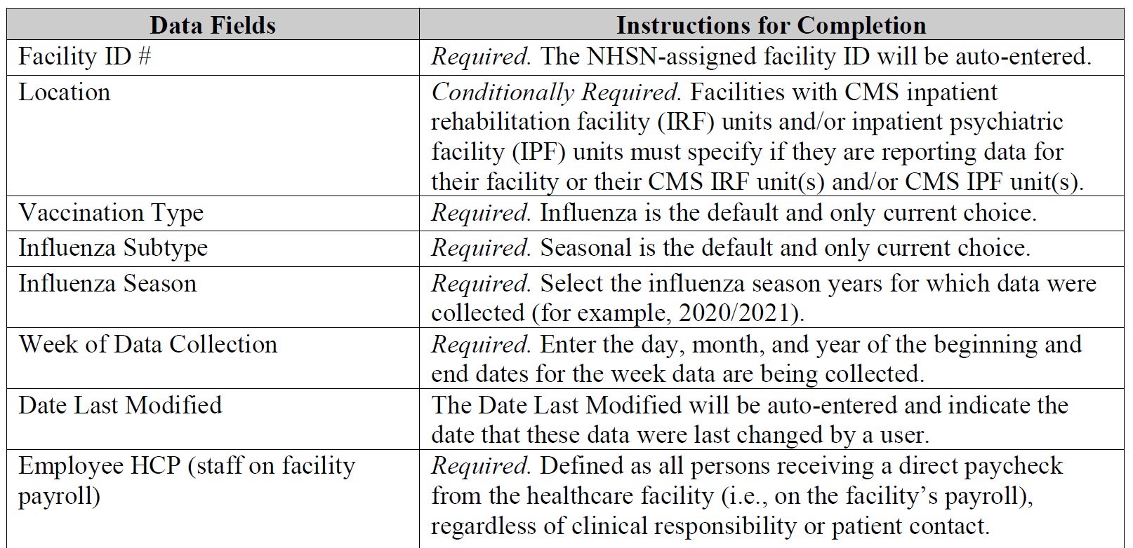
Tables of Instructions
Tables of instructions provide detailed definitions of the denominator and numerator categories
Review instructions before collecting and entering data
Access instructions at: https://www.cdc.gov/nhsn/enrolled-facilities/index.html
Click on facility type (e.g., acute care facilities)
Click on “Surveillance for Healthcare Personnel Vaccination”
19

Slide 20
How do I get started in NHSN?
20
Notes:
Now we will briefly go over the requirements for weekly data reporting.

Slide 21
NHSN Landing Page
Select the HCP Safety Component
21
Notes:
Once you are on the NHSN landing page, facilities will need to select the Healthcare Personnel Safety Component in the drop-down box.

Slide 22
HPS Component Home Page
Select ‘Vaccination Summary’ and ‘Weekly Vaccination Summary’ on the left-hand navigation bar
22
Notes:
Once you are on the homepage for the HPS Component, click on ‘Vaccination Summary’ on the left-hand navigation bar.
You will then see options for ‘Annual Vaccination Flu Summary’ and ‘Weekly Vaccination Summary.’ For weekly reporting, click on ‘Weekly Vaccination Summary.’

Slide 23
Entering Weekly Vaccination Data
23
Notes:
You will then see a screen in a calendar format for the vaccination summary data.
Please note that at the top of the screen is a link to the Vaccine Adverse Event Reporting System (VAERS) to report adverse events following vaccination.
To report weekly influenza vaccination data, please click on the week for which you wish to enter data.

Slide 24
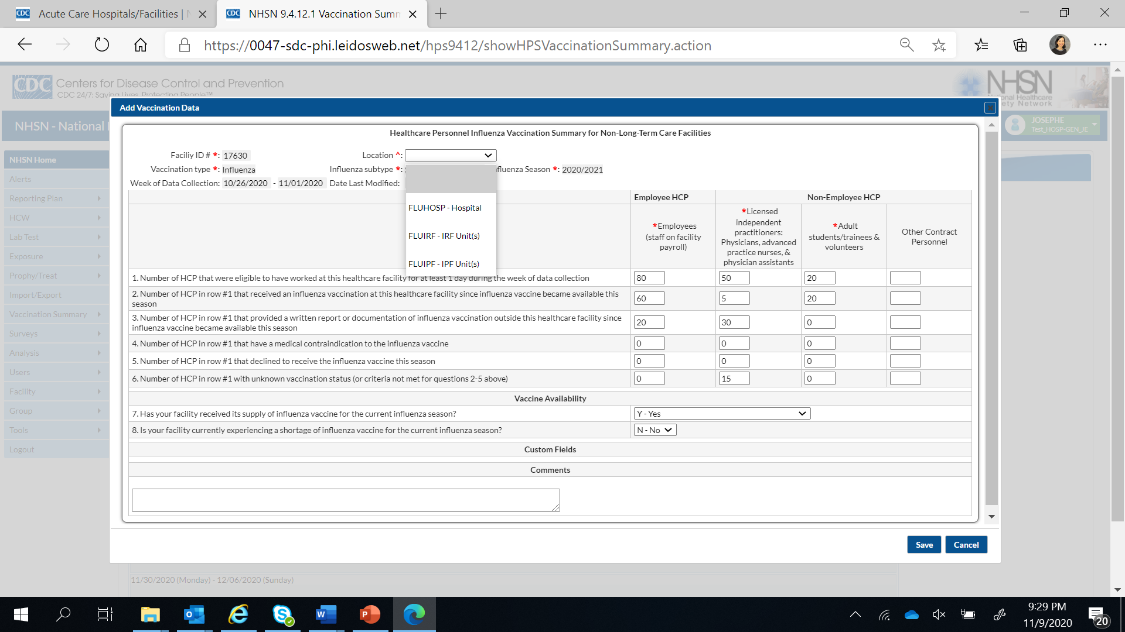
Entering Weekly Vaccination Data (cont.)
24
Notes:
You will then see the data entry screen for entering weekly influenza vaccination data. If you are an acute care facility, please indicate from the drop-down box if you are reporting data for the hospital or units within the hospital.
You will see that the fields with the asterisks are required categories.
Select the correct influenza season in the drop-down box. For example, the current influenza season should be: 2020-2021.
Enter the data for questions 1-6 on vaccine coverage. Please note that the sum of questions 2 through 6 should be equal to the number listed in question 1.
Answer two questions on vaccine availability using the drop-down boxes.
Once you are finished entering data, please click on the ‘Save’ button at the bottom of the screen.

Slide 25
Entering Weekly Vaccination Data (cont.)
25
Notes:
After clicking on the ‘Save’ button, a message should appear on your screen indicating that the data have been saved successfully.

Slide 26
Editing Weekly Vaccination Data
26
Notes:
Once data have been entered as saved in NHSN, you will see a tab for each existing record on the calendar page.
To edit weekly data, click on the “Flu Vax’ tab.

Slide 27
Editing Weekly Vaccination Data (cont.)
27
Notes:
After editing data, please click the ‘Save’ button at the bottom of your data entry screen.

Slide 28
Reporting cumulative vaccination data
28

Slide 29
Reporting Cumulative Data for HCP
 | Employees Sept. 14-20 | Employees Sept. 21-27 | Employees Sept. 28-Oct. 5
1. Number of HCP that were eligible to have worked at this healthcare facility for at least 1 day during the week of data collection | 100
2. Cumulative number of HCP in question #1 that received an influenza vaccination at this healthcare facility since influenza vaccine became available this season | 50
3. Cumulative number of HCP in question #1 that provided a written report or documentation of influenza vaccination outside this healthcare facility since influenza vaccine became available this season | 10
29

Slide 30
Reporting Cumulative Data for HCP (cont.)
 | Employees Sept. 14-20 | Employees Sept. 21-27 | Employees Sept. 28-Oct. 5
1. Number of HCP that were eligible to have worked at this healthcare facility for at least 1 day during the week of data collection | 100 | 100
2. Cumulative number of HCP in question #1 that received an influenza vaccination at this healthcare facility since influenza vaccine became available this season | 50 | 60
3. Cumulative number of HCP in question #1 that provided a written report or documentation of influenza vaccination outside this healthcare facility since influenza vaccine became available this season | 10 | 10
30

Slide 31
Reporting Cumulative Data for HCP (cont.)
 | Employees Sept. 14-20 | Employees Sept. 21-27 | Employees Sept. 28-Oct. 5
1. Number of HCP that were eligible to have worked at this healthcare facility for at least 1 day during the week of data collection | 100 | 100 | 100
2. Cumulative number of HCP in question #1 that received an influenza vaccination at this healthcare facility since influenza vaccine became available this season | 50 | 60 | 70
3. Cumulative number of HCP in question #1 that provided a written report or documentation of influenza vaccination outside this healthcare facility since influenza vaccine became available this season | 10 | 10 | 10
31

Slide 32
Data Reporting in NHSN: Influenza Vaccination versus COVID-19 Cases
Weekly Influenza vaccination data
Optional reporting
Cumulative vaccination data (all vaccinations administered to date)
COVID-19 case data
Required reporting
Incidence case data (cases diagnosed each week)
32

Slide 33
Resources
33
Notes:
The next few slides will outline some resources that may be helpful to you.

Slide 34
Resource: The NHSN Website
Visit: https://www.cdc.gov/nhsn/enrolled-facilities/index.html for training materials
Click on facility type (e.g., acute care facilities)
Click on “Surveillance for Healthcare Personnel Vaccination”
Data collection forms
Tables of Instructions
Training slides
34
Notes:
The NHSN website contains links to the data collection forms, tables of instructions for reporting data, and training slides that facilities can use when reporting weekly influenza vaccination data through NHSN.
Click on facility type (e.g., acute care facilities)
Click on ‘Surveillance for Healthcare Personnel Vaccination’

Slide 35
Questions or Need Help?
E-mail user support at: nhsn@cdc.gov
Please include ‘Weekly Flu Summary’ in the subject line of the e-mail
35
Notes:
If you have any questions about NHSN, please send an e-mail to user support at nhsn@cdc.gov. Please include ‘Weekly Flu Summary’ in the subject line of the e-mail.
This concludes the presentation. Thank you so much for your time.

